Slide 1
Guidelines For Online Examinations given By KUK
Presented By
Naresh Kumar
Asstt.Prof.

Slide 2
Features
The examination will be conducted in blended mode. (offline + online)

Slide 3
1. The question papers as per date-sheet will be uploaded on the University Website www.kuk.ac.in at 10.00AM and it would also be sent to the Chairperson/Director/Principal through E-Mai1.
2. The Director /Principa1 of the Institute/College will upload the question papers at their official website also.

Slide 4
3. List of Nodal Centres will be uploaded on the University website www.kuk.ac.in by the Secrecy Branch.
4. Required:
Proper internet Connection
Student Phone No.
Most important ALERTNESS

Slide 5
FOR STUDENTS
1: How much percentage of answers attemption required by University from student side?
Ans: 1. Student must attempt 50% paper by choosing any questions from question paper given by University.
2. Student must ensure that he/she has attempted answer carrying 50% of maximum marks.

Slide 6
2: What will be the Time limit of each Online Exam?
Ans: 03:00 hrs.
(including DOWNLOADING & SUBMISSION)

Slide 7
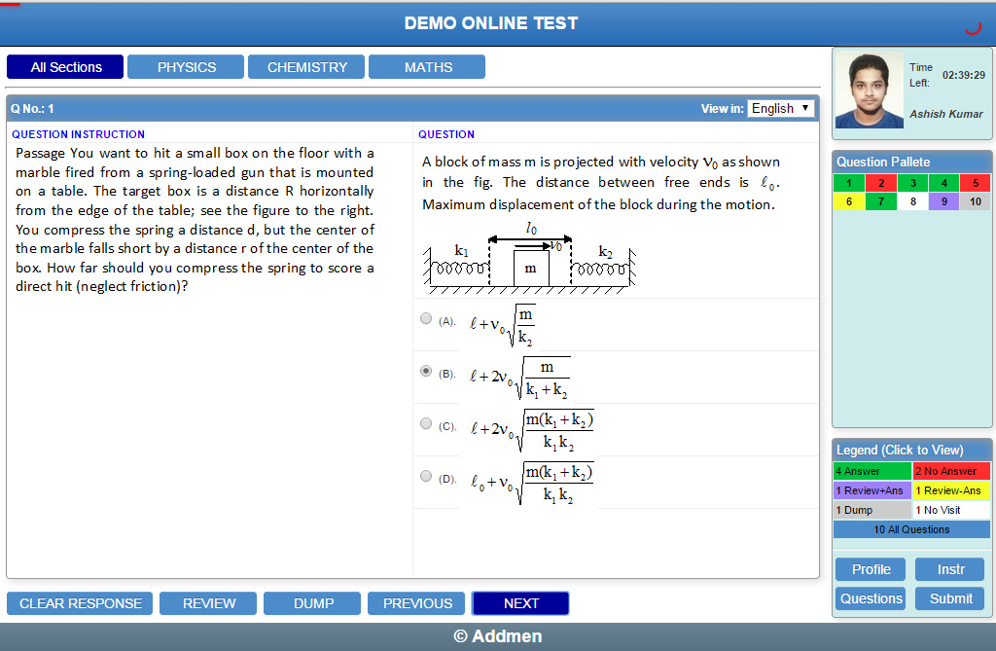
3: Main requirements for Online Question Paper.
Ans:1. Download/note down the question paper
2. Solve the question paper from their remote location on A-4 size paper in his/her own handwriting .
3. Maximum page limit would be 20 (Twenty).
4. Attempt questions Serial No. wise
5. Mark Page No. on the Answer-Book

Slide 8
Details for First Page Of Answer Booklet
On the first page of the Answer- Book, he/she will fill the following details: -
Univ. Roll No. (in figures) in words
Name of the student iii) Class/Semester
iv) Name of the Paper: v) Code of Paper:
vi) Total No. of Pages written by candidate: vii) Date of Exam
viii) Sign. of the Stu dent:

Slide 9
Query/ solution
In case any student does not have mobile phones or facing network problem etc., in that case he/she can seek help from his/her parent Department/Institute/College regarding availability of question paper as well as deposit of hard copy of answer-book.

Slide 10
Important things to remember
The candidate will not write his Mobile No. etc. Otherwise Unfair Means Case will be made.
While attempting the paper the candidate will use blue/b1ack ball pen only.
3. Candidate will ensure for your paper regarding option or any other things etc.
4.University will not entertain any complaint.
5.Must sign on each page otherwise that page will not evaluate.

Slide 11
Specimen OF ANSWER SHEET

Slide 14
THANKS

